Slide 1
MDC Replication

Slide 2
MDC Replication

Slide 4
Riak Enterprise
Notes:
-- exclusive

Slide 5
Replication *) Fullsync *) Realtime
Notes:
-- key, value, and metada together make an object

Slide 6
Fullsync
Notes:
-- datacenter parts

Slide 7
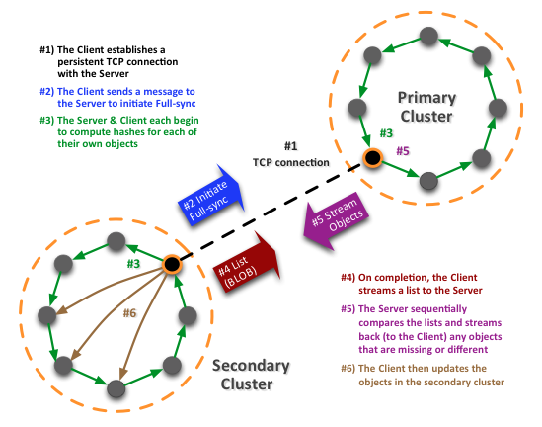

Slide 8
Realtime
Notes:
-- an instance of Riak
-- an Erlang VM
-- almost always running on a separate server

Slide 9
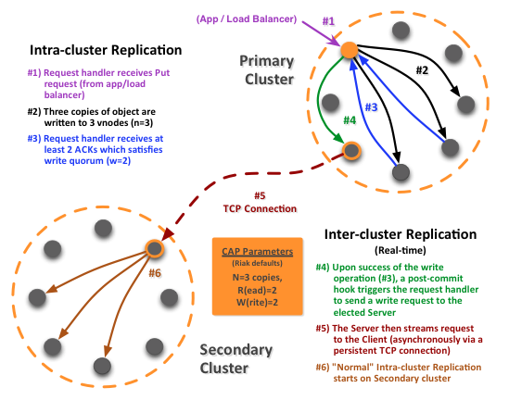
Notes:
----- Meeting Notes (8/28/12 11:58) -----
Check to see if there's a way to compare checksums w/o triggering the actual sync.
What happens when there's a failure in the repication call.

Slide 10
Use Cases *) Geographic Locality *) Load Balancing *) Cloud Bursting *) Disaster Recovery *) Archival *) Backup *) Live Migration
Notes:
-- key, value, and metada together make an object

Slide 11
Replication *) Fullsync *) Realtime
Notes:
-- key, value, and metada together make an object

Slide 12
MDC Replication

